Slide 1
Amanda Gorman
Student Health & Human Services
Office of Human Relations, Diversity & Equity
July 2022
Stories of Excellence
Notes:
Teachers, please feel free to supplement with this article:
https://www.tolerance.org/magazine/teach-this-the-hill-we-climb-and-the-2021-inauguration
Teacher: thank you for choosing to share this advisory lesson with our students.

Slide 2
Welcome Which job would you rather have?
President of the United States
World Famous Rockstar
Notes:
Please engage the students in a brief check in.

Slide 3
Objectives
Learn about poet laureate Amanda Gorman.
Discuss the challenges Amanda faced as a child, and how she channeled them into her art.
Reflect on overcoming challenges and accomplishing goals.
Notes:
Read the objectives aloud for the students. Acknowledge that this can be heavy topic and invite the students to participate at their comfort level. Remind the students of classroom norms.

Slide 4
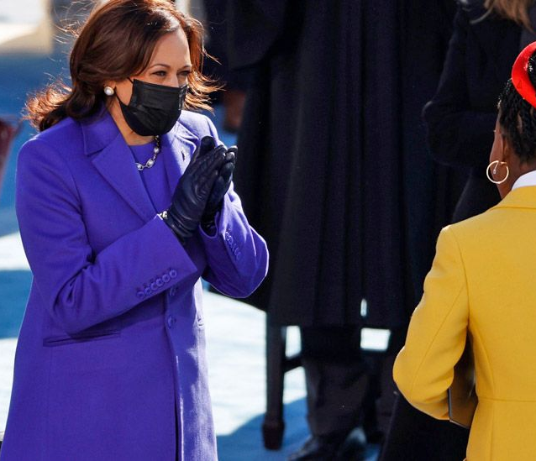
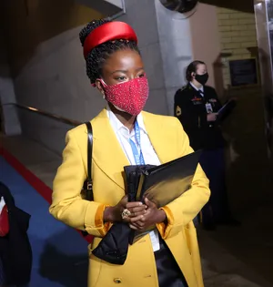
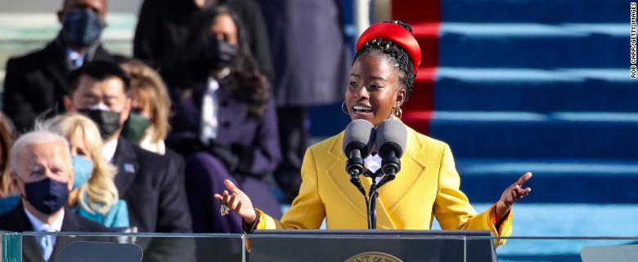
Making History
In 2014 (age 16), Amanda Gorman was chosen as the youth poet laureate in Los Angeles.
In April of 2017 (age 19), Amanda was the first person to be named National Youth Poet Laureate.
On January 20, 2021, Amanda made history as the youngest poet to perform at a presidential inauguration.
Notes:
Read the slide aloud for the students.

Slide 5
Class Poll
Did you hear Amanda read her poem at the inauguration?
Notes:
Invite the students to engage in this poll by giving a thumbs up or thumbs down as to whether or not they heard Amanda Gorman recite poetry during the presidential inauguration.

Slide 6
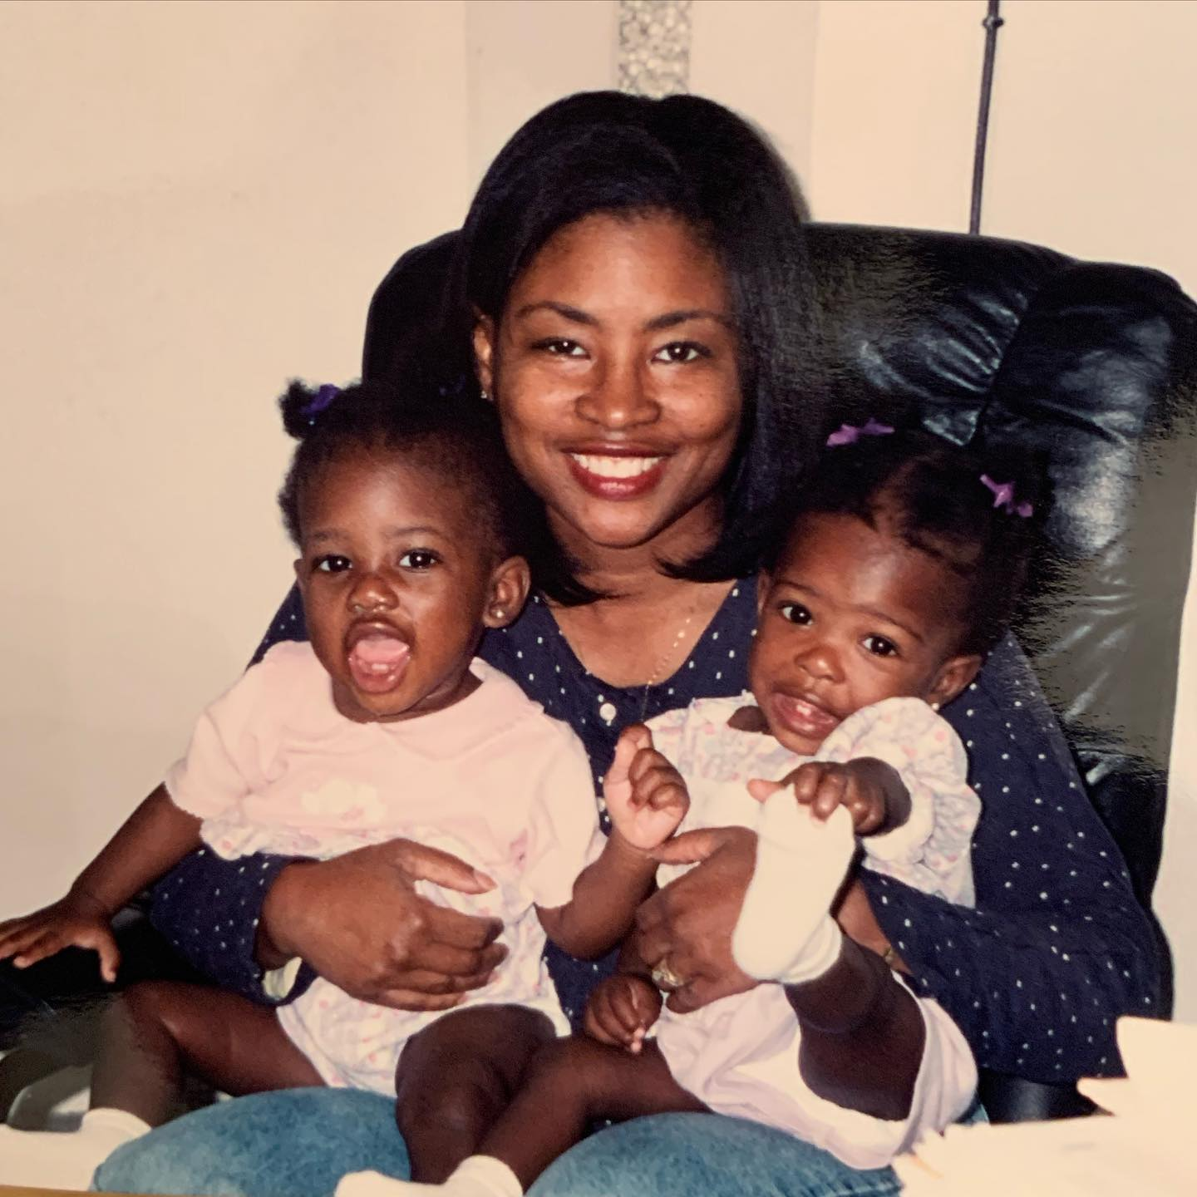
Who is Amanda Gorman?
Amanda Gorman was born in 1998 in Los Angeles California.
Amanda has two siblings, including a twin sister.
Amanda attended a private school in Santa Monica for kindergarten through high school.
Amanda's mom is a 6th grade teacher at a charter middle school in South Los Angeles.
Notes:
Read the slide aloud for the students. Advise the students that the picture of of Amanda Gorman, her twin and her mom.

Slide 7
Speech Imepdiment
Amanda often speaks of how growing up with a speech impediment encouraged her to find refuge in writing.
Ultimately, Amanda says performing her poetry helped her to teach herself how to say certain sounds and improve her speech challenges.
Notes:
Video link: https://www.youtube.com/watch?v=ePiZc5yP7KA
Read the slide aloud for the students. Play the video (5:55)

Slide 8
Reflection
Amanda Gorman struggled with a speech impediment throughout her life and used writing to help her overcome.
What are some of the ways you have overcome some challenges you've faced?
Notes:
Engage the students in the reflection questions. Remind the students of class norms.

Slide 9
Additional Accomplishments
Amanda is a graduate of Harvard University
Amanda has performed for the Obama White House, as well as at the Library of Congress.
In 2015, Amanda published a book The One for Whom Food Is Not Enough
In September 2021 the children's book Amanda wrote, called Change Sings was released.
Amanda is the founder of a non-profit organization called One Pen, One Page.
Notes:
Read the slide aloud for the students.

Slide 10
Reflection
Amanda Gorman has accomplished all of this at by just 22 years old.
What are some goals you have that you hope to accomplish?
Notes:
Engage the students in the reflection questions. Remind the students of class norms.

Slide 11
The Hill We Climb
Notes:
Video Link: https://www.youtube.com/watch?v=Jp9pyMqnBzk
Play the video for the students (5:56) - let the students know this was the day of the inauguration.
Link to transcript of the poem https://thehill.com/homenews/news/535052-read-transcript-of-amanda-gormans-inaugural-poem

Slide 12
Your words
Words have the power to transport us.
Select one line from Amanda’s poem. Reflect on how that moved you.
Notes:
Engage the students in the reflection questions. Remind the students of class norms.

Slide 13
Check Out Would you rather...
Nap
Write
Listen to/make Music
run
Notes:
Praise the students for their participation, critical thinking and adherence to classroom norms. Remind students that all feelings are valid especially during this season in their lives/our nations history. Engage students in this check out question.

Slide 14
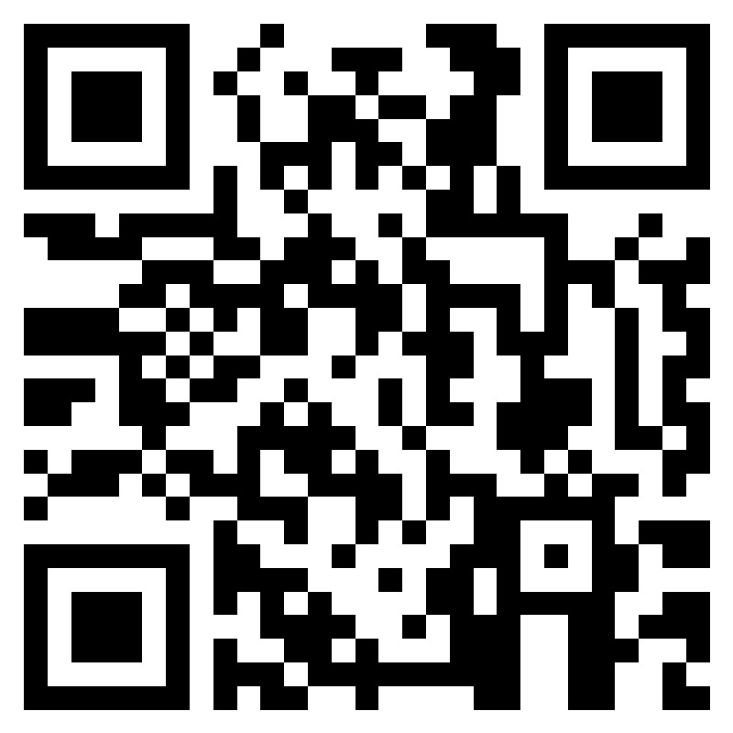
Teacher Survey
Notes:
Teacher please complete the brief feedback survey by scanning the QR code or using the link below.
https://forms.office.com/Pages/ResponsePage.aspx?id=oUAqBCixxEqGSAFv-hIUh7oXrttstiBCsAXIu5FQ_QRUN09SMFZDT0FaNE9PSTBRTk9CME42WURWUy4u

Slide 15
Human Relations, Diversity & Equity
Notes:
Please reach out to your local district HRDE team member for additional support or trainings.

